Slide 1
18.404/6.840 Lecture 10
Last time: - The Reducibility Method for proving undecidability and T-unrecognizability
- General reducibility
- Mapping reducibility
Today: (Sipser §5.2) - The Computation History Method for proving undecidability
- The Post Correspondence Problem is undecidable
- Linearly bounded automata
- Undecidable problems about LBAs and CFGs
1

Slide 2
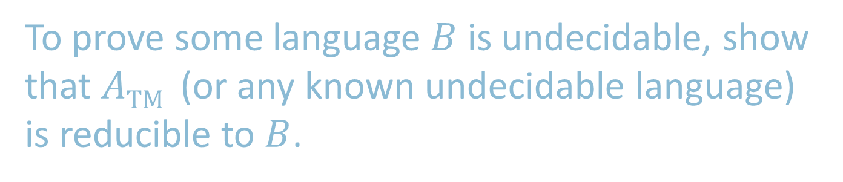
Remember
To prove some language $B$ is undecidable, show that $A\text{TM}$ (or any known undecidable language) is reducible to $B$.
2

Slide 3

Revisit Hilbert’s 10th Problem
Recall $D=\left\{〈p〉\right|$ polynomial $p\left(x_{1}, x_{2}, …, x_{k}\right)=0$ has integer solution)
Hilbert’s 10th problem (1900): Is $D$ decidable?
Theorem (1971): No
Proof: Show $A\text{TM}$ is reducible to $D$. [would take entire semester]
Do toy problem instead which has a similar proof method.
Toy problem: The Post Correspondence Problem.
Method: The Computation History Method.
3

Slide 4


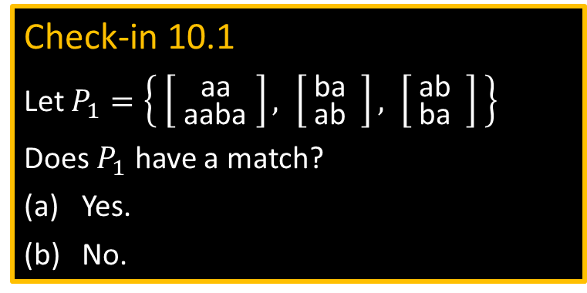
Post Correspondence Problem
Given a collection of pairs of strings as dominoes:
$P=\left\{ \left[ {t_{1} \atop b_{1} }\right], \left[ {t_{2} \atop b_{2}} \right], … , \left[ {t_{k} \atop b_{k}} \right] \right\}$
a match is a finite sequence of dominos in $P$ (repeats allowed) where the concatenation of the $t$’s = the concatenation of the $b$’s.
Match = $\left[ {t_{i_{1}} \atop b_{i_{1}} }\right] \left[ {t_{i_{2}} \atop b_{i_{2}}} \right] … \left[ {t_{i_{l}} \atop b_{i_{l}}} \right]$ where $t_{i_{1}}t_{i_{2}}⋯t_{i_{l}} = b_{i_{1}}b_{i_{2}}⋯b_{i_{l}}$
Example: $P=\left\{ \left[ {\text{ab} \atop \text{aba} }\right], \left[{\text{b}\text{aa}\text{b} \atop \text{aba} }\right], \left[ {\text{ba} \atop \text{aa} } \right], \left[ {\text{abab} \atop \text{b} } \right] \right\}$
Check-in 10.1
Let $P_{1}=\left\{ \left[ {\text{b}\text{a}\text{a}\text{b} \atop \text{a}\text{aba} }\right], \left[ {\text{ba} \atop \text{a}\text{b} } \right], \left[ {\text{ab} \atop \text{b}\text{a} } \right] \right\}$
Does $P_{1}$ have a match?
Yes.
No.
Problem: Given $P$, is there a match?
Theorem: Undecidable!
Let$PCP=\left\{〈P〉\right| P$ has a match $\}$
Proof: Show $A\text{TM}$ is reducible to $PCP$.
First: the Computation History Method.
abaabaaaabab
abaabaaaabab
Match:
Check-in 10.1
4

Slide 5








TM Configurations
Defn: A configuration of a TM is a triple $(q,p,t)$ where $q$ = the state, $p$ = the head position, $t$ = tape contents representing a snapshot of the TM at a point in time.
$$6$$
˽
˽
…
Configuration: $(q_{3}, 6,\text{aaaaaabbbbb})$
$$q_{3}$$
aaaaaabbbbb
Encoding as a string: $\text{aaaaa}q_{3}\text{abbbbb}$
$$t_{1}$$
$$t_{2}$$
Encode configuration $(q,p,t)$ as the string $t_{1}qt_{2}$ where $t=t_{1}t_{2}$ and the head position is on the first symbol of $t_{2}$.
5

Slide 6












TM Computation Histories
Defn: An (accepting) computation history for TM $M$ on input $w$ is a sequence of configurations $C_{1}, C_{2}, …,C\text{accept}$ that $M$ enters until it accepts.
Encode a computation history $C_{1}, C_{2}, …,C\text{accept}$ as the string $C_{1} \# C_{2} \# ⋯ \# C\text{accept}$ where each configuration $C_{i}$ is encoded as a string.
A computation history for $M$ on $w=w_{1}w_{2}⋯w_{n}$. Here say $δ\left(q_{0},w_{1}\right)=(q_{7},\text{a},\text{R})$
and $δ\left(q_{7},w_{2}\right)=(q_{8},\text{c},R)$.
$$C_{1} \# C_{2} \# C_{3} \# ⋯ \# C_{\text{accept}}$$
$$q_{0}w_{1}w_{2}⋯w_{n}$$
$$\#$$
$$\text{a}q_{7}w_{2}⋯w_{n}$$
$$\#$$
$$\text{a}\text{c}q_{8}w_{3}⋯w_{n}$$
$$\#$$
$$⋯$$
$$\#$$
$$⋯ q\text{ac}\text{cept} ⋯$$
6

Slide 7


Linearly Bounded Automata
Defn: A linearly bounded automaton (LBA) is a 1-tape TM that cannot move its head off the input portion of the tape.
LBA
a
a
a
a
a
b
b
Tape size adjusts to length of input.
Let $A\text{LBA}$ $=\left\{〈B,w〉\right|$LBA $B$ accepts $w$ }
Theorem: $A\text{LBA}$ is decidable
Proof: (idea) If $B$ on $w$ runs for long, it must be cycling.
Claim: For inputs of length $n$, an LBA can have only $\left|Q\right|×n×{\left|Γ\right|}^{n}$ different configurations.
Therefore, if an LBA runs for longer, it must repeat some configuration and thus will never halt.
Decider for $A\text{LBA}$:
$D\text{A}\text{−}\text{LBA}$ $=$ “On input $〈B,w〉$
1. Let $n=|w|$.
2. Run $B$ on $w$ for $\left|Q\right|×n×{\left|Γ\right|}^{n}$ steps.
3. If has accepted, accept.
4. If it has rejected or is still running, reject.”
must be looping
7

Slide 8









$E\text{LBA}$ is undecidable
Let $E\text{LBA}$ $=\left\{〈B〉\right|$ $B$ is an LBA and $L\left(B\right)=∅$}
Theorem: $E\text{LBA}$ is undecidable
Proof: Show $A\text{TM}$is reducible to $E\text{LBA}$. Uses the computation history method.
Assume that TM $R$decides $E\text{LBA}$
Construct TM $S$ deciding $A\text{TM}$
$S=$ “on input $〈M,w〉$
1. Construct LBA $B_{M,w}$ which tests whether its input $x$ is an accepting computation history for $M$ on $w$, and only accepts $x$ if it is.
2. Use $R$ to determine whether $L\left(B_{M,w}\right)=∅$.
3. Accept if no. Reject if yes.”
$B_{M,w}=$“On input $x$
1. Check if $x$ begins $C_{1}\#$ where $C_{1}$ is start config of $M$ on $w$.
2. Check that each $C_{i+1}$ legally follows from $C_{i}$ for each $i$.
3. Check that final configuration is accepting.
4. Accept if all checks pass. Reject if any fail.”
Check-in 10.2
What do you think of the Computation History Method? Check all that apply.
Cool !
Just another theorem.
I’m baffled.
I wish I was in 6.046.
$$B_{M,w}$$
$$q_{0}w_{1}w_{2}⋯w_{n}$$
#
$$\text{a}q_{7}w_{2}⋯w_{n}$$
#
$$\text{a}\text{c}q_{8}w_{3}⋯w_{n}$$
#
$$⋯$$
#
$$⋯ q\text{ac}\text{cept} ⋯$$
$$C_{1} C_{2} C_{3} ⋯ C_{\text{accept}}$$
No additional tape is needed so is an LBA.
8
Check-in 10.2

Slide 9



$PCP$is undecidable
Recall $PCP=\left\{〈P〉\right| P$ has a match $\}$
Theorem: $PCP$is undecidable
Proof: Show $A\text{TM}$is reducible to $PCP$. Uses the computation history method.
Technical assumption: Match must start with $\left[{t_{1} \atop b_{1}}\right]$. Can fix this assumption.
Assume that TM $R$ decides $PCP$
Construct TM $S$ deciding $A\text{TM}$
$S=$ “on input $〈M,w〉$
1. Construct PCP instance $P_{M,w}$ where a match corresponds to a computation history for $M$ on $w$.
2. Use $R$ to determine whether $P_{M,w}$ has a match.
3. Accept if yes. Reject if no.”
9

Slide 10


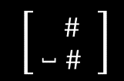








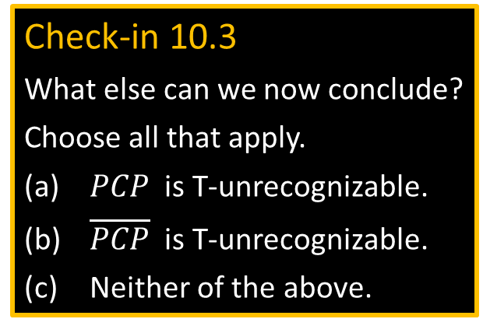
Constructing $P_{M,w}$
Make $P_{M,w}$ where a match is a computation history for $M$ on $w$.
$\left[{u_{1} \atop v_{1}}\right]=\left[{\# \atop {\#q}_{0}w_{1}⋯w_{n}\#}\right]$ (starting domino)
For each $a,b∈Γ$ and $q,r∈Q$ where $δ\left(q,a\right)=(r,b,\text{R})$
put $\left[{q_{0}a \atop b_{0}r}\right]$ in $P_{M,w}$ and put $\left[{{ a}_{1} \atop { a}_{1}}\right]$ in $P_{M,w}$ and $\left[{{ \#}_{1} \atop { \#}_{1}}\right]$ also $\left[{{ \#}_{1} \atop { \#}_{1}\text{˽} }\right]$
(Handles right moves. Similar for left moves.)
Ending dominos to allow a match if $M$ accepts:
$\left[{{ a}_{1}q_{\text{accept}} \atop { q}_{\text{accept}}}\right]$ $\left[{q_{\text{accept}}{ a}_{1} \atop { q}_{\text{accept}} }\right]$ $\left[{q_{\text{accept}}{ \#\#}_{1} \atop { \#}_{1}}\right]$
Check-in 10.3
What else can we now conclude?
Choose all that apply.
$PCP$ is T-unrecognizable.
$\overline{PCP}$ is T-unrecognizable.
Neither of the above.
$\left[ { { \#}_{1} \atop {\text{˽} \#}_{1}}\right]$
Illustration: $w=223$
$$δ\left(q_{0}, 2\right)=(q_{7},4,\text{R})$$
$$\#q_{0}223\#$$
$$\#$$
$$\# q_{\text{accept}} \# \#$$
Match completed!
… one detail needed.
. . .
. . .
$$\#q_{0}223\#4q_{7}23\#$$
$$\# ⋯q_{\text{accept}}⋯ \#$$
$$\# q_{\text{accept}} \# \#$$
10
Check-in 10.3

Slide 11
















$ALL\text{CFG}$ is undecidable
Let $ALL\text{CFG}=\left\{〈G〉\right| G$ is a CFG and $L\left(G\right)=Σ^{∗}\}$
Theorem: $ALL\text{CFG}$ is undecidable
Proof: Show $A\text{TM}$ is reducible to $ALL\text{PDA}$ via the computation history method.
Assume TM R decides $ALL\text{PDA}$ and construct TM $S$ deciding $A\text{TM}$.
$S=$ “On input $〈M,w〉$
1. Construct PDA $B_{M,w}$ which tests whether its input $x$ is an accepting computation history for M on w, and only accepts $x$ if it is NOT.
2. Use $R$ to determine whether $L\left(B_{M,w}\right)=Σ^{∗}$.
3. Accept if no. Reject if yes.”
$B_{M,w}$ operation:
Nondeterministically push some $C_{i}$ and pop to compare with $C_{i+1}$. Accept if invalid step of M, or if start wrong, or if end isn’t accepting.
$$B_{M,w}$$
$$w_{n}$$
$$q_{0}w_{1}w_{2}⋯w_{n}$$
#
$$\text{a}q_{7}w_{2}⋯w_{n}$$
#
$$\text{a}\text{c}q_{8}w_{3}⋯w_{n}$$
#
$$⋯$$
#
$$⋯ q\text{ac}\text{cept} ⋯$$
$$⋮$$
$$w_{2}$$
$$C_{1} C_{2} C_{3} ⋯ C_{\text{accept}}$$
$$C_{2}^{ℛ}$$
$$w_{1}$$
Reverse even-numbered $C_{i}$to allow comparing with $C_{i+1}$ via stack.
$$q_{0}$$
11

Slide 12

Computation History Method - recap
Computation History Method is useful for showing the undecidability of problems involving testing for the existence of some object.
$D$ Is there an integral solution (to the polynomial equation)?
$E\text{LBA}$ Is there some accepted string (for the LBA)?
$PCP$ Is there a match (for the given dominos)?
$ALL\text{CFG}$ Is there some rejected string (for the CFG)?
In each case, the object is the computation history in some form.
12

Slide 13

Quick review of today
Defined configurations and computation histories.
Gave The Computation History Method to prove undecidability.
$A\text{LBA}$ is decidable.
$E\text{LBA}$ is undecidable.
$PCP$is undecidable.
$ALL\text{CFG}$ is undecidable.
13

Slide 14

Eliminating the technical assumption
Technical assumption: Match must start with $\left[{t_{1} \atop b_{1}}\right]$. Fix this assumption as follows.
Let $P=\left\{ \left[ {t_{1} \atop b_{1} }\right], \left[ {t_{2} \atop b_{2}} \right], … , \left[ {t_{k} \atop b_{k}} \right] \right\}$ where we require match to start with $\left[{t_{1} \atop b_{1}}\right]$.
Create new $P′=\left\{ \left[ {{\overset{̿}{t}}_{1} \atop {\overset{̿}{b}}_{1} }\right], \left[ {{\hat{t}}_{1} \atop {\hat{b}}_{1} }\right], \left[ {{\hat{t}}_{2} \atop {\hat{b}}_{2}} \right], … , \left[ {{\hat{t}}_{k} \atop {\hat{b}}_{k}} \right] \right\}$
For any string $u=u_{1},…, u_{k}$, let
$⋆u = ∗u_{1}∗u_{2}∗⋯∗u_{k}$
$u⋆ = u_{1}∗u_{2}∗⋯∗u_{k}∗$
$⋆u⋆ = ∗u_{1}∗u_{2}∗⋯∗u_{k}∗$
Then let $P^{′}= \left\{ \left[{⋆t_{1} \atop ⋆b_{1}⋆ }\right], \left[ {⋆t_{1} \atop b_{1}⋆}\right], \left[ {⋆t_{2} \atop b_{2}⋆} \right], … , \left[ {{⋆t}_{k} \atop b_{k}⋆} \right],\left[ {∗\$ \atop { \$}_{0} }\right]\right\}$
14

Slide 15
MIT OpenCourseWare
https://ocw.mit.edu
18.404J Theory of Computation
Fall 2020
For information about citing these materials or our Terms of Use, visit: https://ocw.mit.edu/terms.

